Slide 1
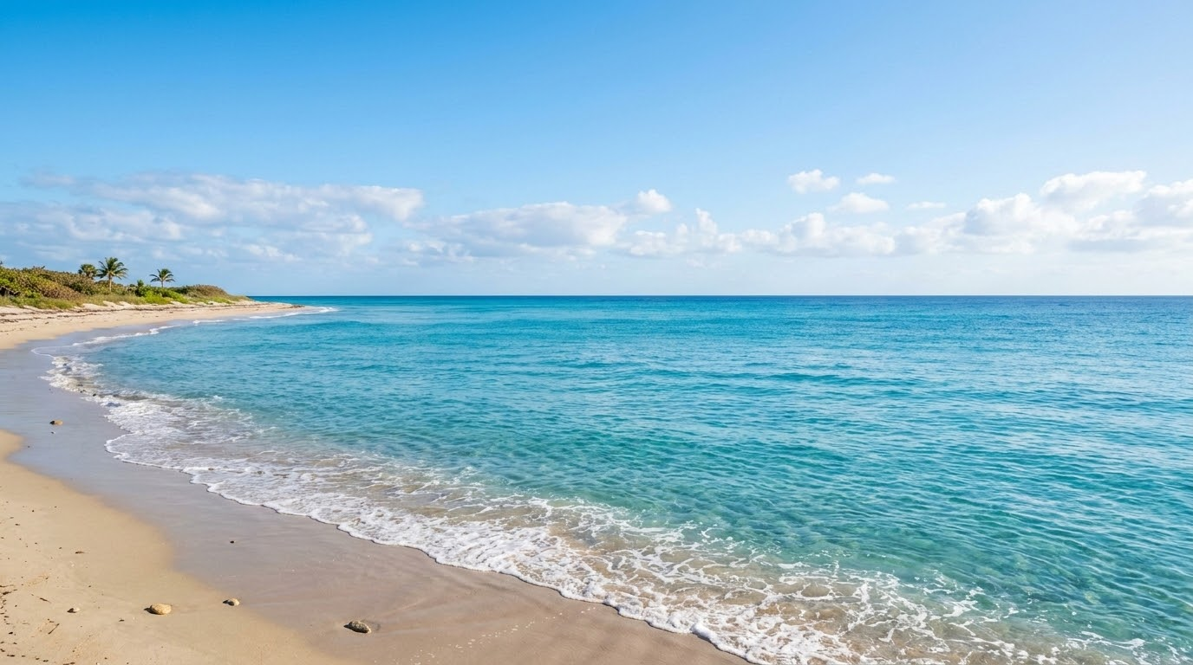


Data Wrangling Quest by Ironhack
SharkSafe Marine Travel & Adventure Agency
Data-Informed Product Strategy
A data analytics project designed to explore historical shark incident data and transform it into actionable insights for the marine tourism industry.
Project Team :
Berta Nieto Romero | Juliana Therezo | Sofija Šarafejeva | Yurii Slobodchukov

Slide 2


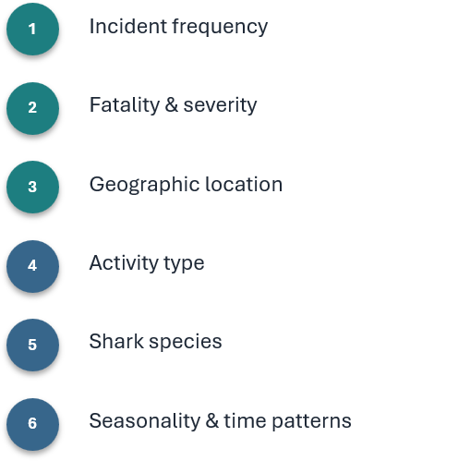
Overview
Data for analysis
Business Case
SharkSafe organizes ocean recreation experiences such as surfing, scuba diving, and shark-watching tours.
The company wants to develop a more data-informed product and safety strategy by understanding how recorded shark incidents vary across destinations, activities, seasons, and time periods.
Core Objective
Identify patterns that could help the company make better decisions about:
🌍 Destinations
🏄 Marine activities
🦈 Shark-watching locations
📅 Tour scheduling
🛟 Customer safety communication
From historical incident data → practical insights for safer, better-informed marine tourism decisions

Slide 3





Data Cleaning Approach
Preparing the historical shark incident dataset for reliable analysis
The raw dataset was cleaned, standardized and transformed before testing the project hypotheses.
Missing & inconsistent data
Handled missing values
Reviewed inconsistent entries
Activity & shark species
Cleaned activity categories
Standardized shark species
where possible
Date transformation
Converted dates and years
Created month and season
variables
Data structure
Removed unnecessary columns
Standardized column names
Checked duplicated records
Location & classifications
Cleaned country
Standardized fatality classifications
Identified incident types
Cleaning Workflow

Slide 4
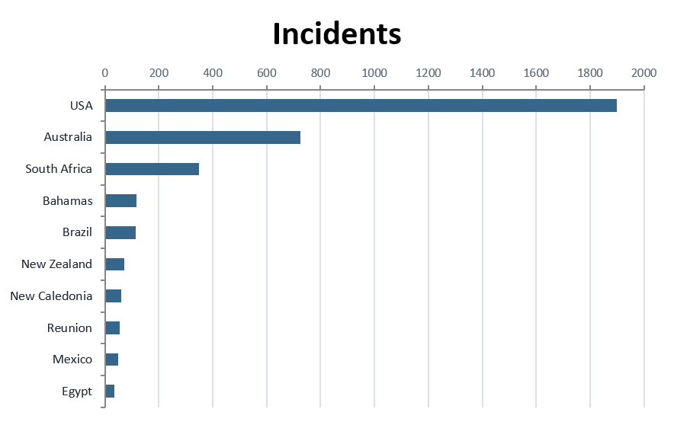
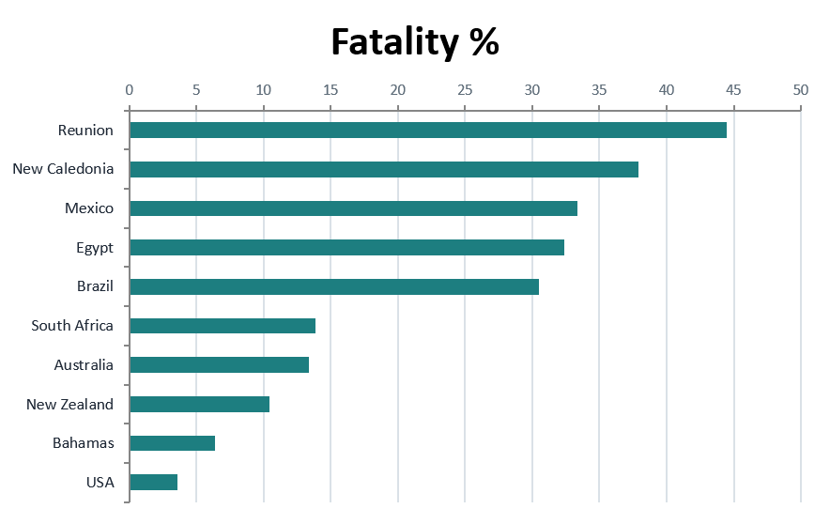

Destination:
Incident Frequency vs. Fatality
Frequency and severity vary substantially across countries
• High Incident Zones: USA & Australia register highest absolute recorded incidents.
• Low Risk Zones: Mediterranean and specific Caribbean islands exhibit minimal historical incident rates.
• Tour Safety Routing: Fatality percentage analysis pinpoints optimal locations for recreational itineraries.

Slide 5
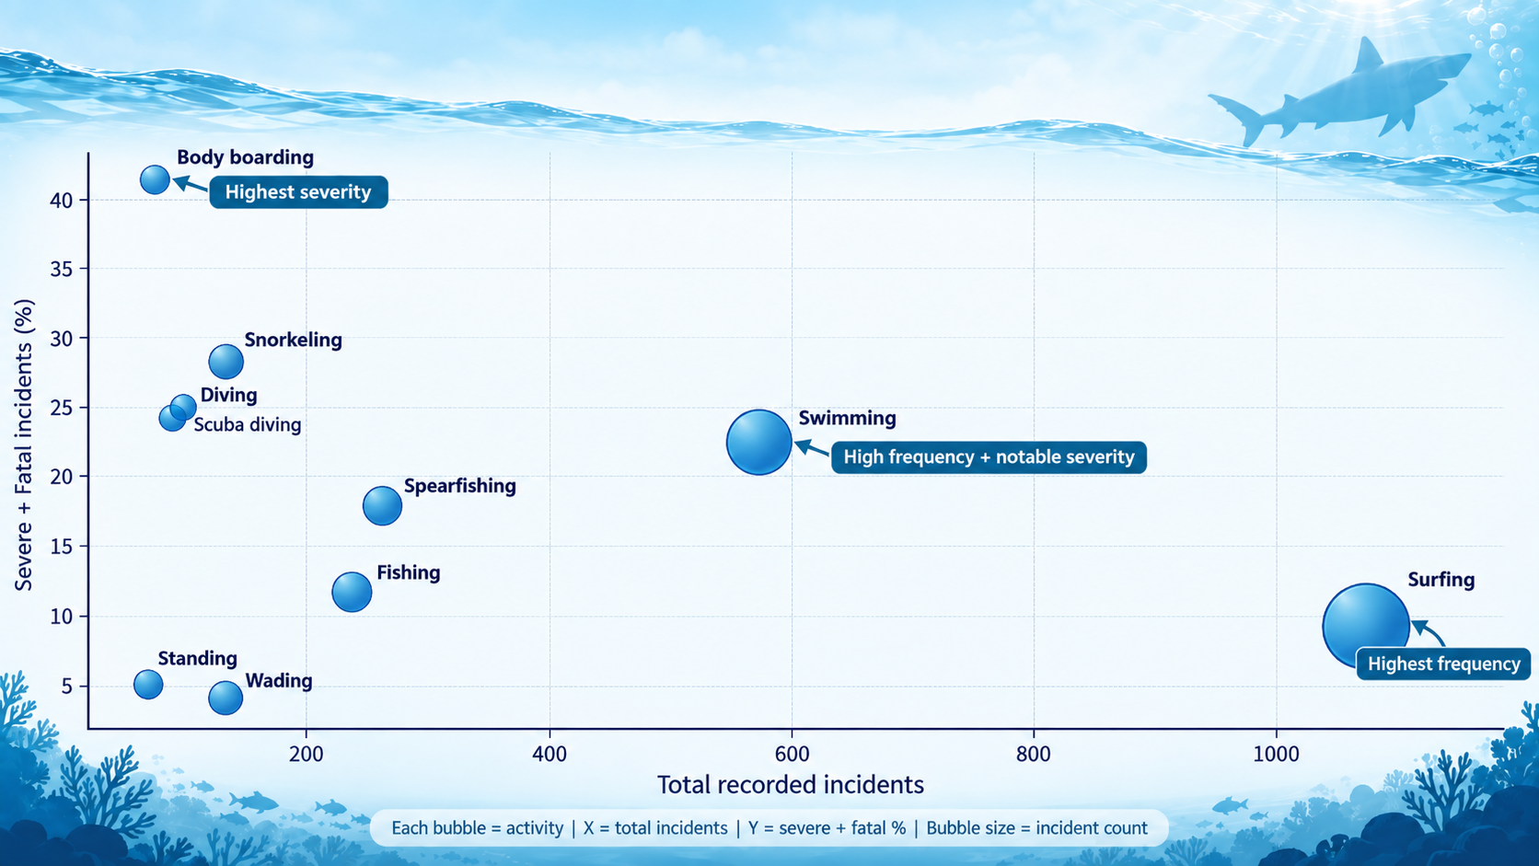
High Frequency ≠ High Severity
H2: Which activities are associated with the most recorded shark incidents, and how severe are the outcomes?
Surfing = highest frequency
1,098 incidents / 27.5% of all recorded cases
Body boarding = highest severity
41.3% severe or fatal outcomes
Swimming = key combined concern
High frequency + 22.5% severe/fatal outcomes
Business implication:
SharkSafe should use activity-specific safety protocols — frequency alone is not enough to assess safety.
Top 10 activities analyzed. Fatality % excludes unknown outcomes. Recorded incidents ≠ true participant risk.

Slide 6
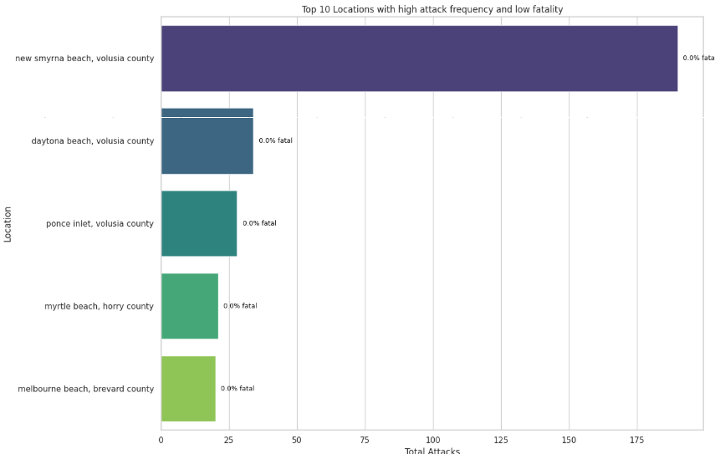
Shark-Watching Destinations: Low-Fatality Encounter Hotspots
Testing the Hypothesis
The analysis of locations meeting the criteria for frequent incidents (more than 20 incidents) and low fatality rates (less than 10%) reveals that:
New Smyrna Beach, Volusia County stands out with the highest number of recorded incidents (190), but with a 0.0% fatality rate, making it the leading candidate under this hypothesis.
Other locations, such as Daytona Beach, Volusia County (34 incidents, 0.0% fatality), Ponce Inlet, Volusia County (28 incidents, 0.0% fatality), Myrtle Beach, Horry County (21 incidents, 0.0% fatality), and Melbourne Beach, Brevard County (20 incidents, 0.0% fatality), also meet these criteria.
These findings suggest that there are indeed locations where the frequency of encounters is high while fatality rates are zero or very low, supporting the premise of the hypothesis for the potential development of controlled shark observation tourism.
Regional Encounter vs. Fatality Comparison
New Smyrna
0% Fatality
Daytona Beach
<0.1% Fatality
Melbourne
0% Fatality
Encounter Volume
Historical Fatality Rate

Slide 7

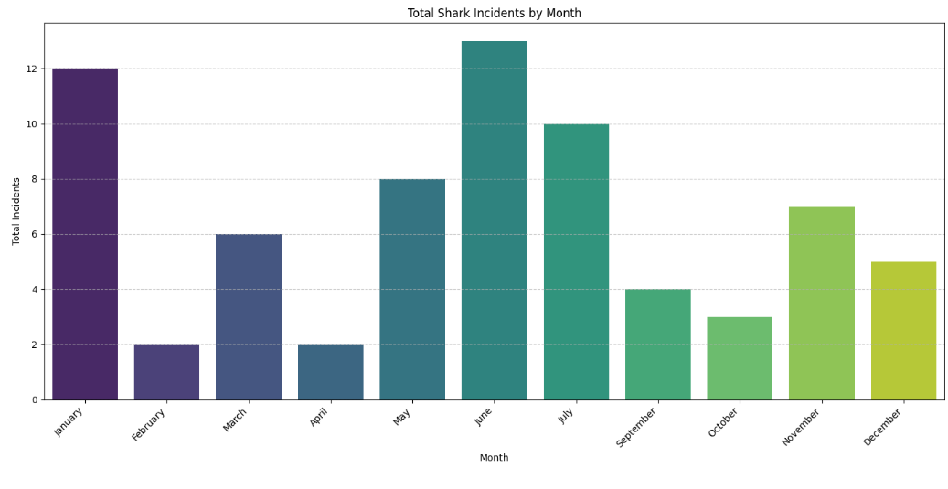
Seasonality: Temporal and Seasonal Patterns in Shark Incidents
Shark incidents show a noticeable seasonal pattern. The data reveals a clear peak during the months of June and January followed by July, suggesting that these months have a higher frequency of registered shark encounters.
Seasonal Peak Patterns
Historical data demonstrates a distinct, predictable peak in incidents during june and january both Northern and Southern hemispheres.
Risk-Minimized Scheduling
SharkSafe will restrict specific water activities during these high-risk windows to systematically minimize operational exposure.

Slide 8
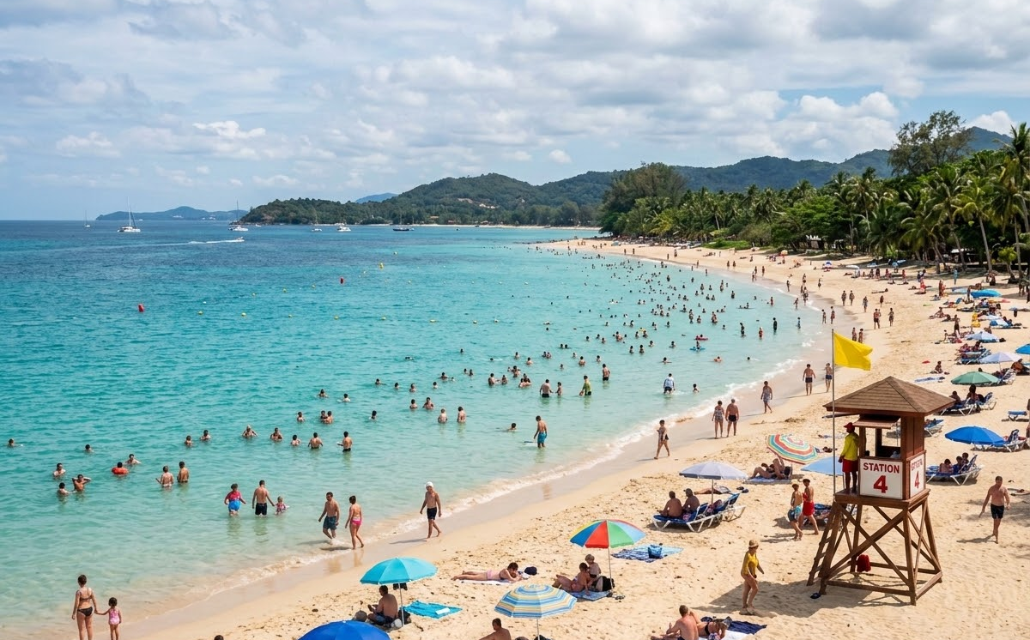
Risk Reduction:
Global unprovoked shark attacks have decreased over the past decade, significantly reducing the incident risk for ocean tourists.
INCIDENT VOLUME
↓ 48.6%
Unprovoked attacks dropped by ~50% over 10 years.
FATAL ENCOUNTERS
↑ 12.0%
Peak severity occurred in 2023 with 19 fatal attacks.
OVERALL SURVIVAL
89.0%
Baseline lethality remains low overall (~11% fatal).
10-YEAR HISTORICAL TREND (2016–2026)
2016
2018
2020
2022
2024
2026
Attack Volume (Dropped 48.6%)
Annual Fatality Rate ( Increased by 8.7%)

Slide 9
What's More Likely to Kill You Than a Shark?
Turns out… almost everything!
~150,000 Deaths / Year
🌊 Drowning & Rip Currents
Accidental drowning in coastal waters, lakes, and rivers claims over 150,000 lives annually—over 10,000x deadlier than sharks.
~6,000–24,000 Deaths / Year
⚡ Lightning Strikes
Global lightning strikes claim 6,000–24,000 lives each year, making flat coastal environments hundreds of times deadlier than sharks.
~50–100 Deaths / Year
🪼 Box Jellyfish
Venomous box jellyfish in tropical waters cause 50–100 confirmed fatalities globally each year, roughly 5–9x more than sharks.
~30–40 Deaths / Year
🤳 Extreme Travel Selfies
Risky selfie attempts on scenic cliffs and high viewpoints claim 30–40 lives annually, making photos 3–4x deadlier than sharks.
🦈 SHARK ATTACK STATISTICAL REALITY: ~11 Fatalities / Year Worldwide

Slide 10
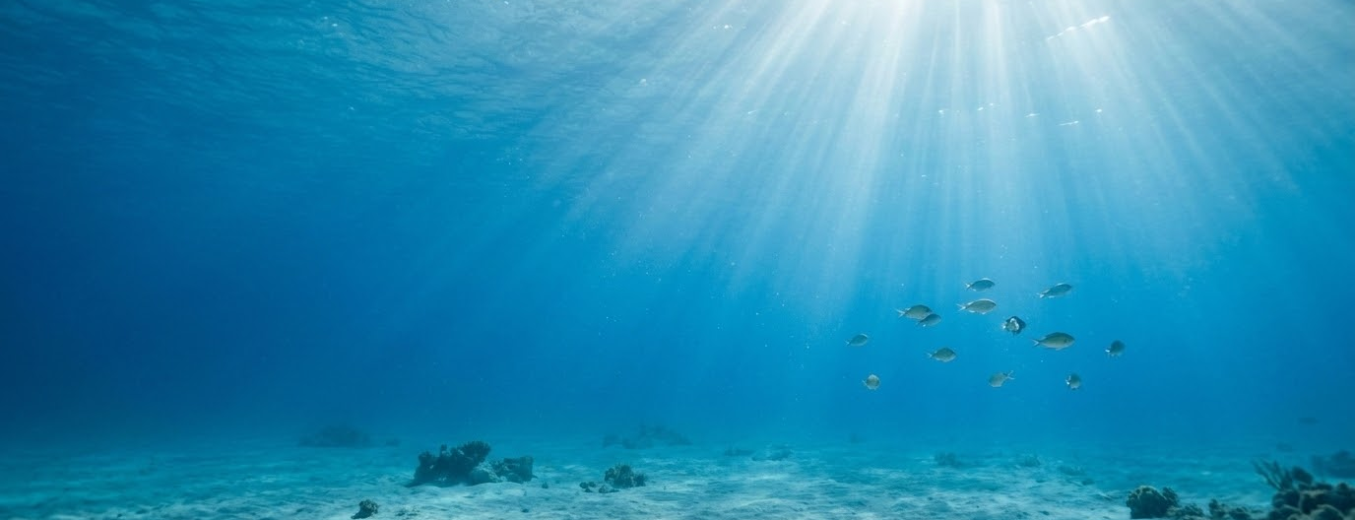
SharkSafe Marine Travel
Thank You for Watching!
Prioritizing ocean safety through data-driven insights and awareness.
Safe Travels & Explore Responsibly
Project Team :
Berta Nieto Romero | Juliana Therezo | Sofija Šarafejeva | Yurii Slobodchukov

